Slide 1



AI Meets Mathematics
An Interactive Chatbot for Primary Math

Slide 2
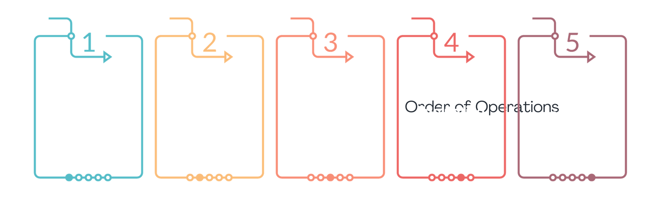
WORKFLOW

Slide 3
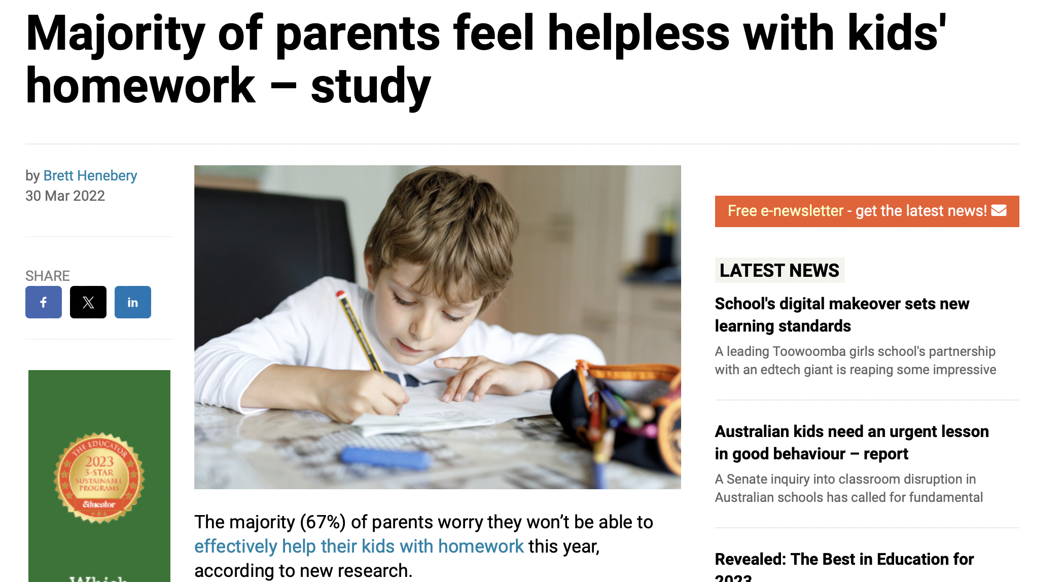
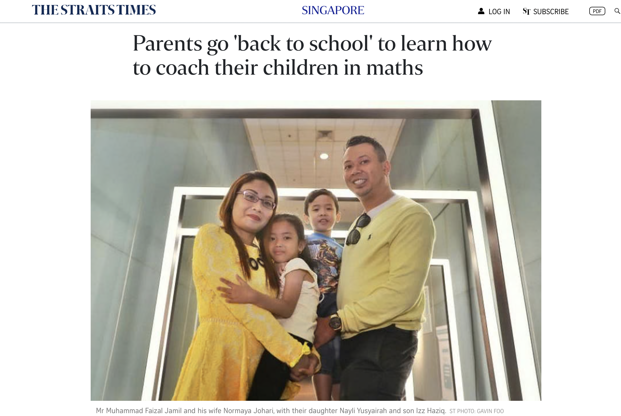

Slide 4
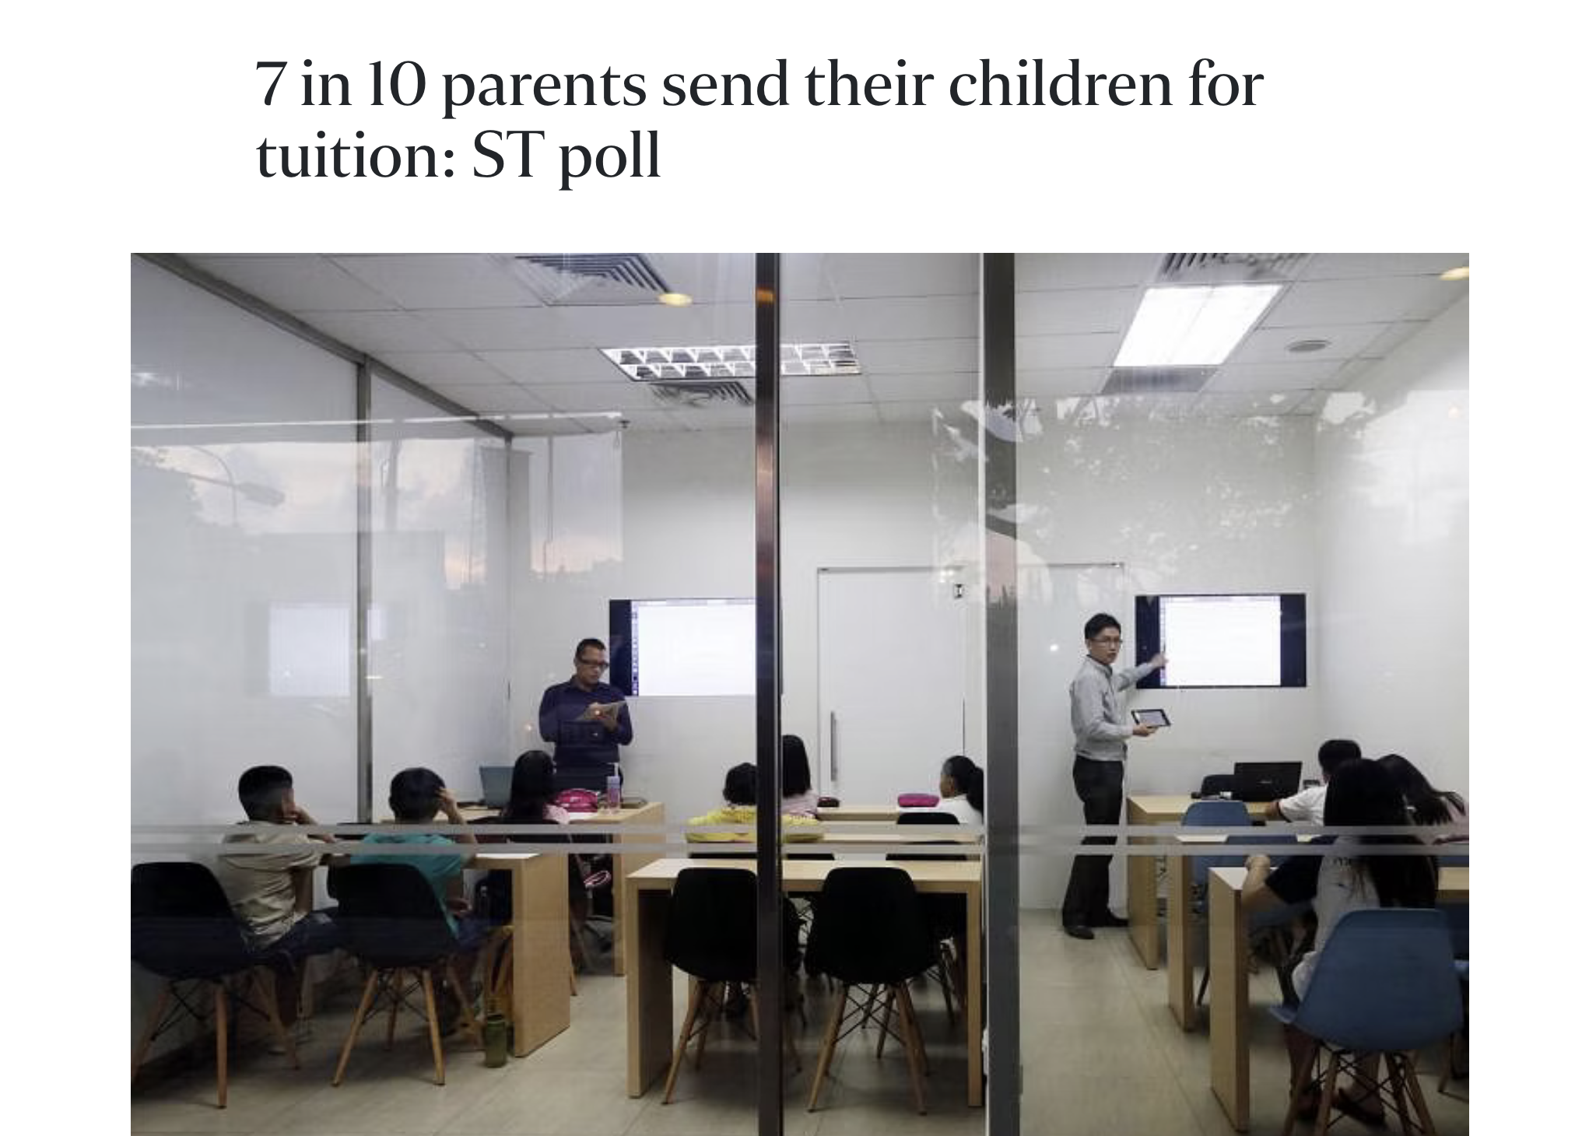
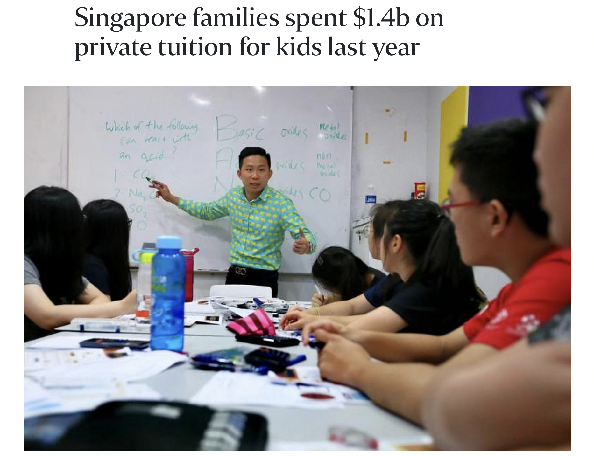

Slide 5
PROBLEM STATEMENT
Our AI-powered chatbot addresses the need for accessible and timely academic support, offering instant and personalized assistance to upper primary students. It fills the gaps in traditional learning by providing on-demand explanations, solutions, and concept clarifications, enhancing student engagement and understanding in mathematics
Success metrics: RAGAS score, Answer Relevancy & Faithfulness
Notes:
Solution:
Provide instant, personalized assistance for math queries.
Offer on-demand explanations and solutions.
Clarify concepts interactively.
Goal: Enhance engagement and understanding in primary mathematics.

Slide 6
DATA

Slide 7
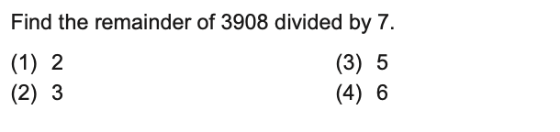
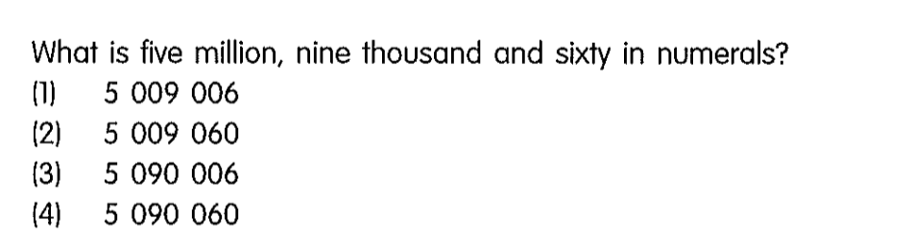
PRIMARY MATH MCQS
80 mathematics multiple choice questions taken from past year PSLE papers
Restricted to questions without pictures

Slide 8
FEATURE ENGINEERING (OPENAI)

Slide 9
SOLUTION
prompt = (
"You are an AI capable of solving math problems. "
"For each problem, select the best answer from the given multiple-choice options. "
"Explain why this choice is correct and why the others are not. "
"Your explanations should be clear and concise, using simple arithmetic and intuitive reasoning when possible. "
f"Here is the problem: {question}\n\n"
"Best Answer and Explanation: \n\n"
)
Express 1.8% as a decimal. (1) 0.0018 (2) 0.018 (3) 0.18 (4) 18
The best answer is (2) 0.018.
Explanation: To convert a percentage to a decimal, you divide by 100. So, 1.8 divided by 100 equals 0.018. The other options are incorrect because they do not represent the correct decimal equivalent of 1.8%. For example, 0.0018 is equivalent to 0.18%, 0.18 is equivalent to 18%, and 18 is equivalent to 1800%, not 1.8%.

Slide 10
COGNITIVE LEVEL
prompt = (
"Here are the classifications:\n"
"AO1: Recall mathematical facts, concepts, rules, and formulae; perform straightforward computations and algebraic procedures.\n"
"AO2: Interpret information; understand and apply mathematical concepts and skills in a variety of contexts.\n"
"AO3: Reason mathematically; analyze information and make inferences; select appropriate strategies to solve problems.\n\n"
f"Classify the following math question into AO1, AO2, or AO3:\n\nQuestion: {question}\n\nClassification:"
)
Express 1.8% as a decimal. (1) 0.0018 (2) 0.018 (3) 0.18 (4) 18
Classification: AO1

Slide 11
TOPIC
prompt = (
"Here are the topics:\n"
"Numbers, Measurement, Statistics, Geometry, Ratio & Percentage, Rate & Speed, Algebra"
f"Classify the following math question into one of the relevant topics:\n\nQuestion: {question}\n\nTopic:"
)
Express 1.8% as a decimal. (1) 0.0018 (2) 0.018 (3) 0.18 (4) 18
Ratio & Percentage

Slide 12
DATA EXPLORATION

Slide 13
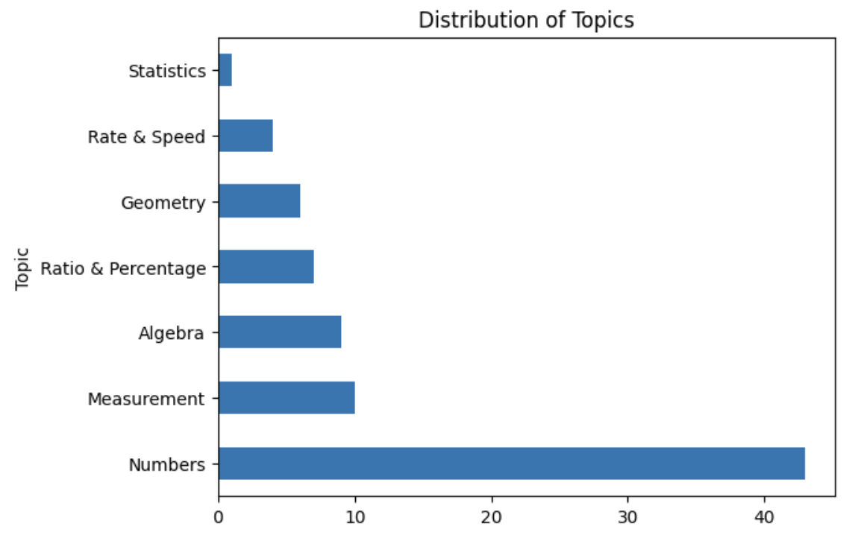
TOPIC DISTRIBUTION

Slide 14
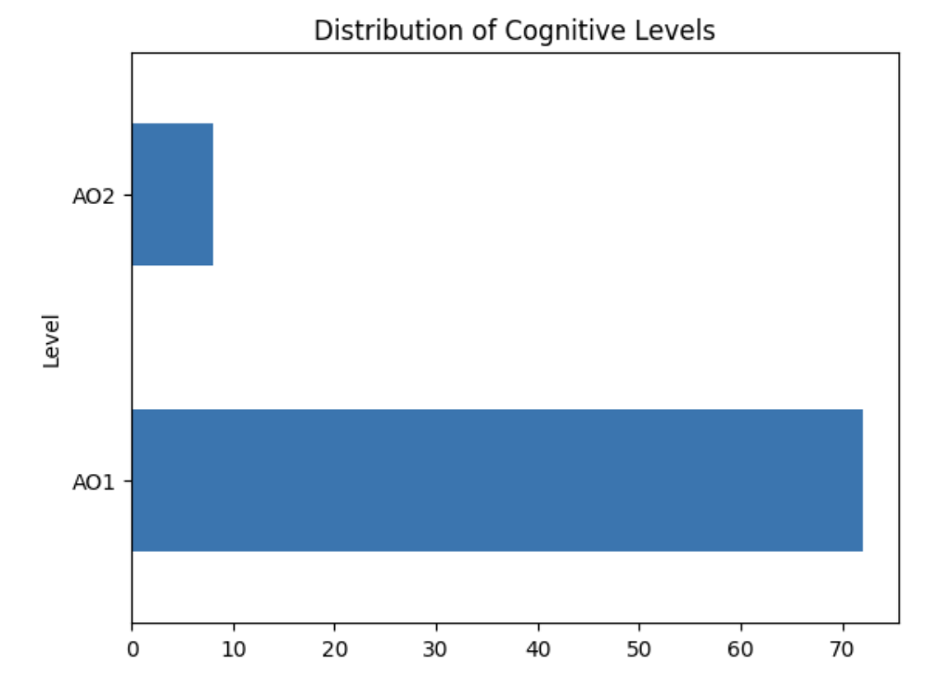
COGNITIVE LEVEL DISTRIBUTION

Slide 15
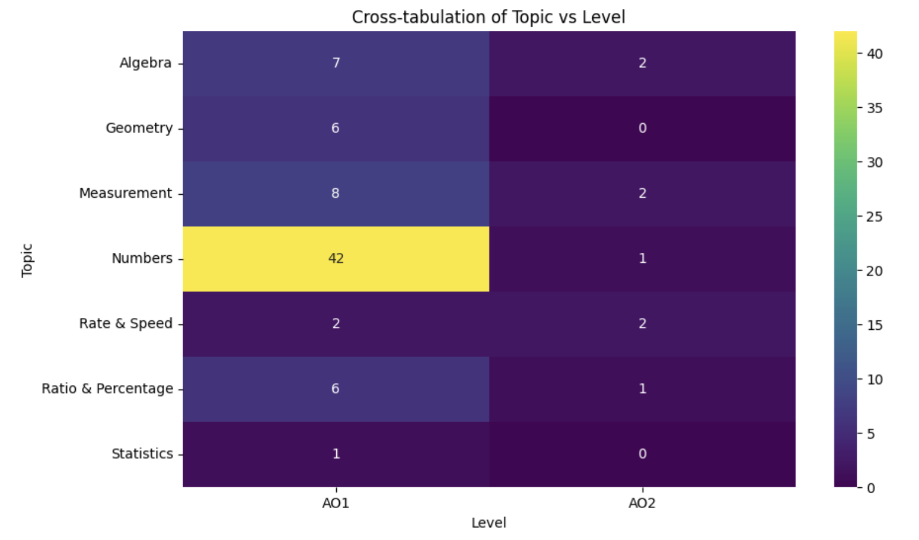
TOPIC VS COGNITIVE LEVEL

Slide 16
BUILDING THE CHATBOT

Slide 17
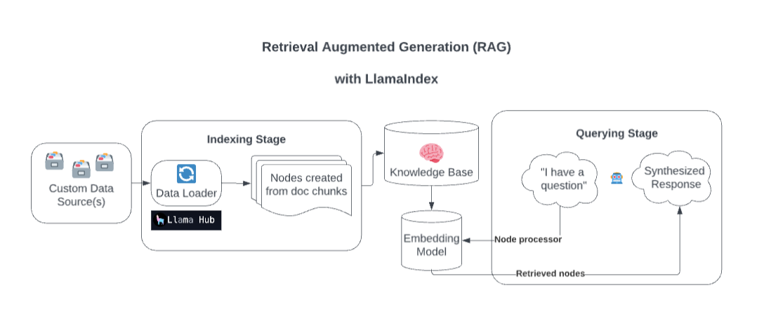
BIG PICTURE
Source: https://discuss.streamlit.io/t/build-a-chatbot-with-custom-data-sources-powered-by-llamaindex/49973

Slide 18



METRICS
RAGAS score
↑ better
Answer Relevancy
↑ better
Faithfulness
↑ better
Notes:
Think of the RAGAS Score as an overall grade for how well the AI model is performing. Just like in school, where you get a grade that reflects your overall performance in a subject, the RAGAS Score is an overall assessment of the AI's ability to understand and respond to questions accurately and reliably.
Answer Relevancy is like how on-topic or relevant a response is to the question asked. If you ask someone a question and they give you an answer that directly addresses your question, that's high relevancy. It's like asking, "What's the weather like today?" and getting a detailed weather report instead of an unrelated answer like, "I like pizza.”
Faithfulness: Faithfulness measures how truthful or accurate the AI's answers are compared to real-world facts or the information it was trained on. It's like when you ask someone for information, and you want to know if you can trust that their answer is correct and not made up or misleading. A high faithfulness score means the AI is giving answers that are more likely to be accurate and trustworthy.

Slide 19
MODELING
TRAIN GPT
(40 QUESTIONS)
EVALUATE
 | RAGAS Score | Answer Relevancy | Faithfulness
GPT 3.5 Turbo | 0.7685 | 0.8517 | 0.7000
Finetuned | 0.8150 | 0.8922 | 0.7500

Slide 20
COMPARING DIFFERENCES
700 305 is ____ more than 680 305. A) 200 tens B) 2 thousands C) 20 thousands (correct) D) 2 ten thousands.
GPT 3.5 TURBO
FINE TUNED
The answer is B) 2 thousands.
The correct answer is C) 20 thousands.

Slide 21
COMPARING DIFFERENCES
What is the value of 3 in 3560? A) 3 thousands B) 3 hundreds C) 3 tens D) 3 ones
GPT 3.5 TURBO
FINE TUNED
3 hundreds
The value of 3 in 3560 is 3 thousands.

Slide 22
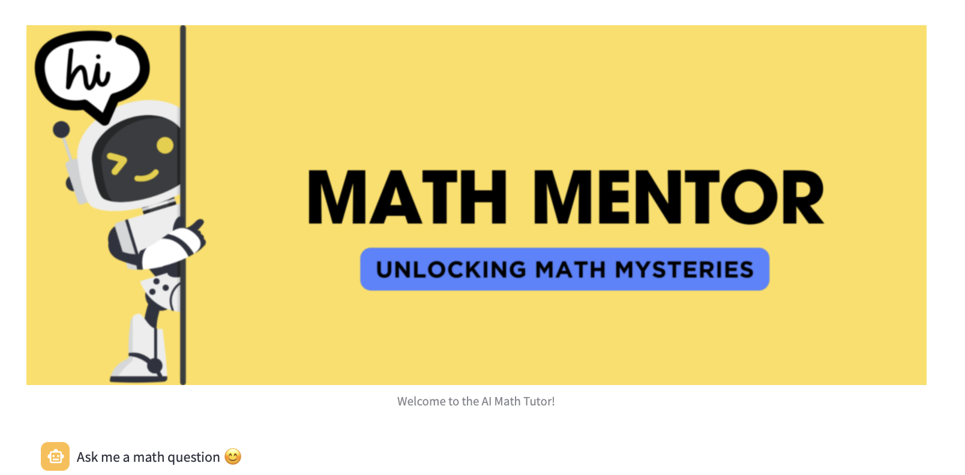
STREAMLIT DEMONSTRATION

Slide 23

CONCLUSION
Functionalities:
On demand explanation
Concept clarification
Assist in problem solving
Invaluable asset
Notes:
This chatbot is not just a tool; it's a virtual companion that brings a range of functionalities to the fingertips of learners
The chatbot has proven to be an invaluable asset in the educational journey of students.

Slide 24
FUTURE WORK
Enhance data repository
Incorporate word problems
Interactive UI elements
Expand range of topics
Include students’ feedback
App Integration

Slide 25


Slide 26
REFERENCE
https://www.straitstimes.com/singapore/education/families-spent-14b-on-private-tuition-for-kids-last-year-as-parents-fork-out
https://www.straitstimes.com/singapore/education/7-in-10-parents-send-their-children-for-tuition-st-poll
https://www.straitstimes.com/singapore/education/parents-go-back-to-school-to-learn-how-to-coach-their-children-in-maths
https://www.theeducatoronline.com/k12/news/majority-of-parents-feel-helpless-with-kids-homework--study/279916

